Slide 1

Duel Reality
Software Engineering
Spring 2010
Josh Kilgore
Obi Atueyi
Tom Calloway
Ye Tian

Slide 2
Summary
Overview
Modules
Graphics (Tom Calloway)
User Interface (Obi Atueyi)
Game Mechanics and AI (Josh Kilgore)
Database (Ye Tian)
Conclusion
Questions

Slide 3
The Overview
Game Description
Details
Game flow, battle flow
Tools
Module Breakdown

Slide 4

Duel Reality: the Game
Total Game play experience
2D
Turn based
Strategy battle simulation
1 Player w/ Ai opponent
(maybe 2)
Upgradable units
7 - level Campaign and Free Battle Modes
Save / Load functionality
Amazing Graphics and Sound
Dynamic Action Points Game play
X
O
X
X
O
O

Slide 5
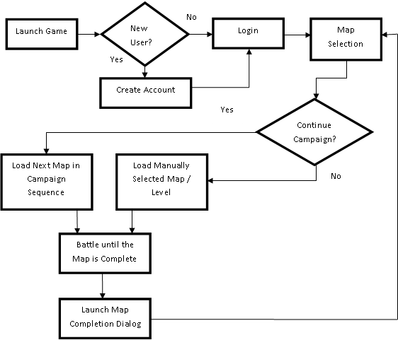
Main Game

Slide 6
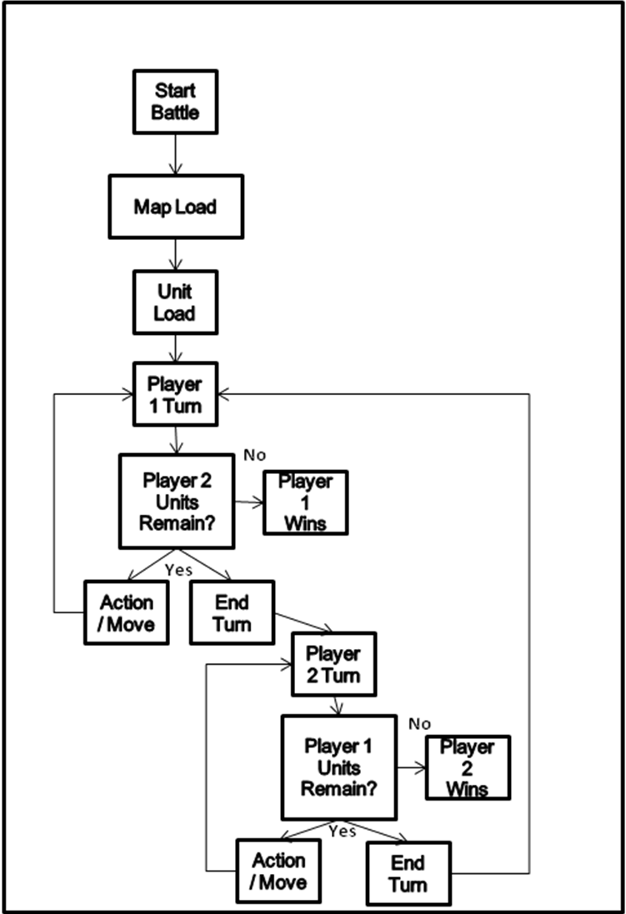
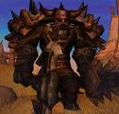
Battles
Basically:
KILL EM ALL

Slide 7



Tools
Development Platform
Graphics
Database
C++

Slide 8
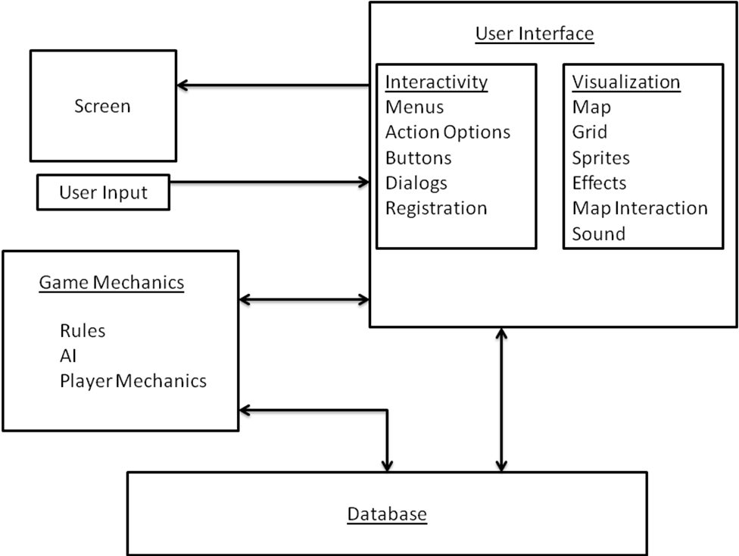
Modules

Slide 9
Overview Summary
Game Description
Details
Game flow, battle flow
Tools
Module Breakdown
Graphics
UI
Game Mechanics
Database
X
O
X
X
O
O

Slide 10
Game Graphics Module Presenter: Tom Calloway
What it is.
What it does.
How it works.

Slide 11
Game Graphics Module “What it is”
Region of the main dialog containing the two-dimensional graphics for the game itself.
Background consists of a static image representing the battle environment.
Top portion (generally the sky) serves as a header region for displaying information.
Lower region contains the game grid with units and objects in play.

Slide 12
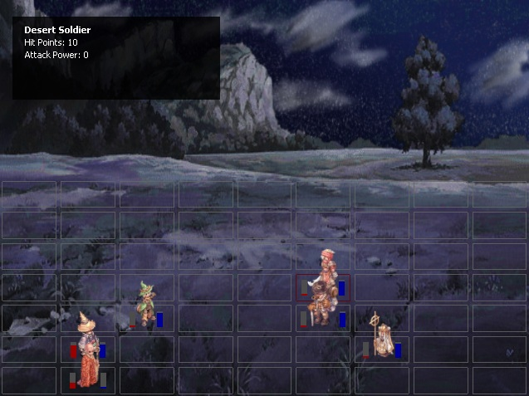
Game Graphics Module “What it does”

Slide 13
Game Graphics Module “What it does”
Accurately reflect the current state of the battle in progress through visual and auditory effects.
Grid displays all units with their health and action points.
Top region displays more detailed statistics for the current user-selected cell.
Allows loading and manipulation of content by both the players and external modules.
Handles movement, attack, and defeat of individual units as requested by the game mechanics and AI.
Handles interaction between the user and the game itself. Specifically, movement, selection, and attack of individual units is supported.

Slide 14
Game Graphics Module Unit Test & Verification
…

Slide 15
Game Graphics Module “Conclusion”
Graphics are crucial to any graphics based video game.
Connects the player to the game by accepting input and accurately presenting information.
Graphics must work well with the game mechanics.
2D overhead and grid were used to provide a solid correlation between the game’s mechanics and it’s graphics.

Slide 16
User Interface Module Summary
Function
Architecture
Model
Conclusion

Slide 17
User Interface Module Function
Provide the framework for the user interaction with the application
Provide the ability for the user to choose desired game settings
Provide status messages or display error messages if user attempts an invalid operation

Slide 18
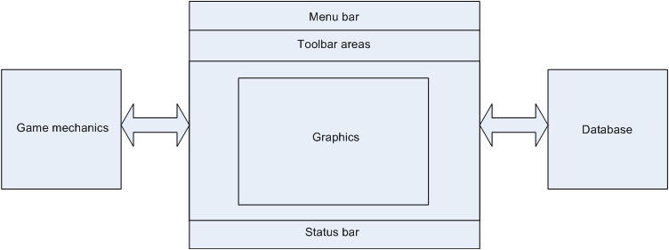
User Interface Module Architecture
Interaction with other modules

Slide 19
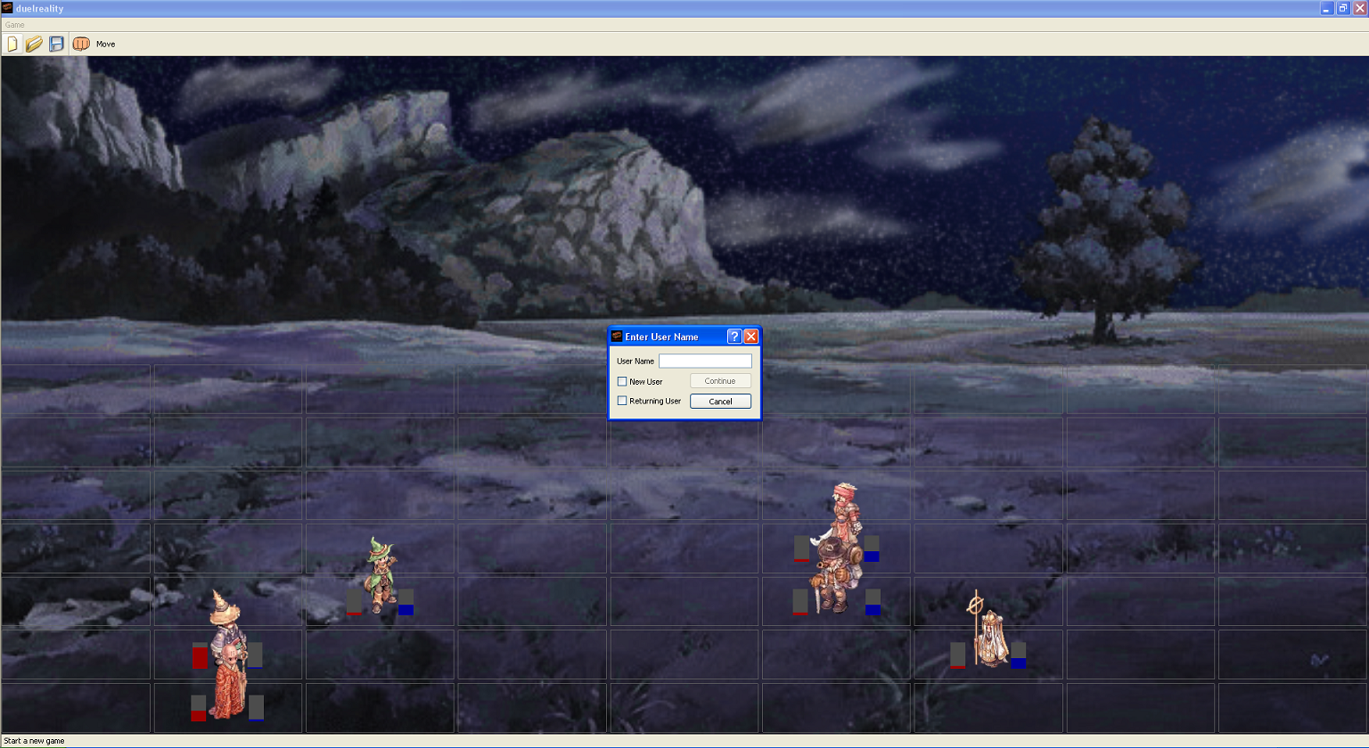
User Interface Module: Model

Slide 20
User Interface Module Conclusion
The User Interface module is what enables the application to respond to the user’s actions.
By communicating with the game mechanics and database modules, the User Interface shares, with the user, data necessary to configure the game
The User Interface module does not display graphics of the active battle, but rather provides the space to view the battle.

Slide 21
Game Mechanics and AI
Unit
Player
Mechanics
Move
Attack
Others
AI
Game Tree
Decision Making

Slide 22




Unit Class
More than just a pretty face
Health
Attack Power
Attack Range
Action Points
Movement Rate
XP
Upgradable Attributes
Teamwork is Key

Slide 23

Player Class
Keep Login ID
Keep Upgraded Units
Continue Campaign from save point
XP Ranking

Slide 24
Game Mechanics
Movement ( X moves, cost Action Points)
X
O
X
O
X
X
X
O
X
O
O
O
O
X
O
X
O
X
X
X
O
X
O
O

Slide 25
Game Mechanics
Attack (X attacks O, range = 1)
X
X
X
O
-2 Health
X
O
X
O
X
O
O
O
O
X
X
X
O
X
O
X
O
X
O
O

Slide 26
Game Mechanics

Slide 27
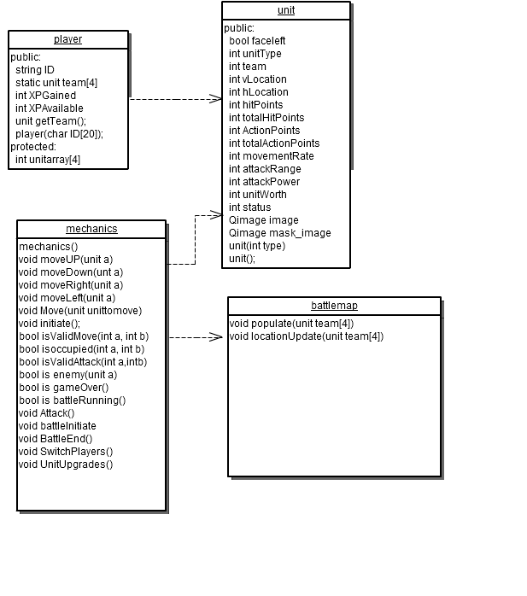
Game Mechanics Class Diagram

Slide 28
AI
Playable Opponent
Board Evaluation
Decision Tree

Slide 29
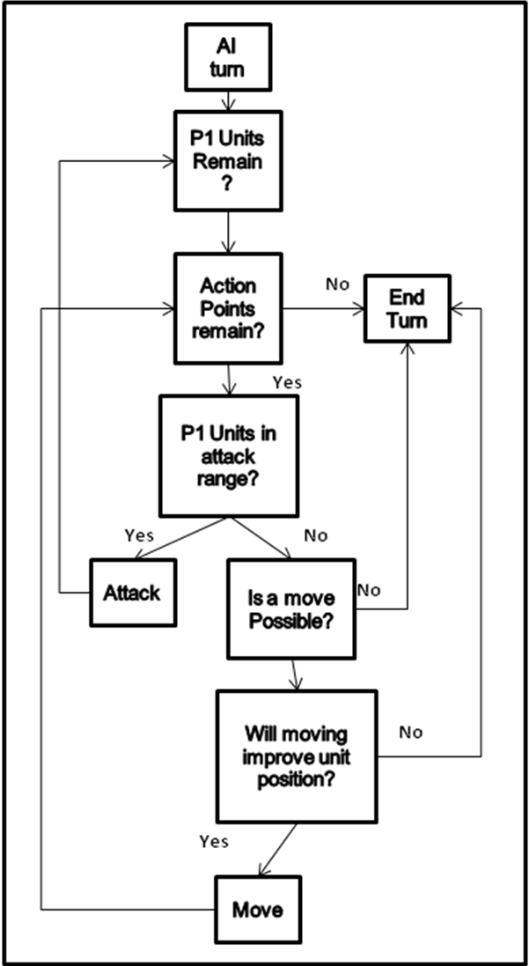
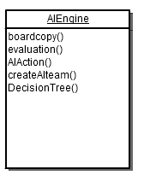
AI - Decision Tree

Slide 30

AI
X
O
X
X
X
O
X
O
X
O
O
O
O
Board Value = 200
Board Value = 300
X
O
X
O
X
X
X
O
X
O
O
O
Board Value = 250
Board Value = 175

Slide 31
Game Mechanics & AI Conclusion
Units
Game Mechanics
AI

Slide 32
Database “Summary”
What Database is?
What Database does in the project?
How Database works?

Slide 33
Database “What Database is”
Databases consist of software-based "containers" that are structured to collect and store information.
Database programs are designed for users so that they can retrieve, add, update or remove information.
The structure of a database is tabular, consisting of rows and columns of information.
A number of database architectures exist. Many databases use a combination of strategies.

Slide 34
Database “What Database does in the project”
The game database contains all of data records
Tables collection of the names, parameters, status of all game units, and the game contents such as maps.
The data is retrieved and overwritten for synchronous/ asynchronous backup.

Slide 35
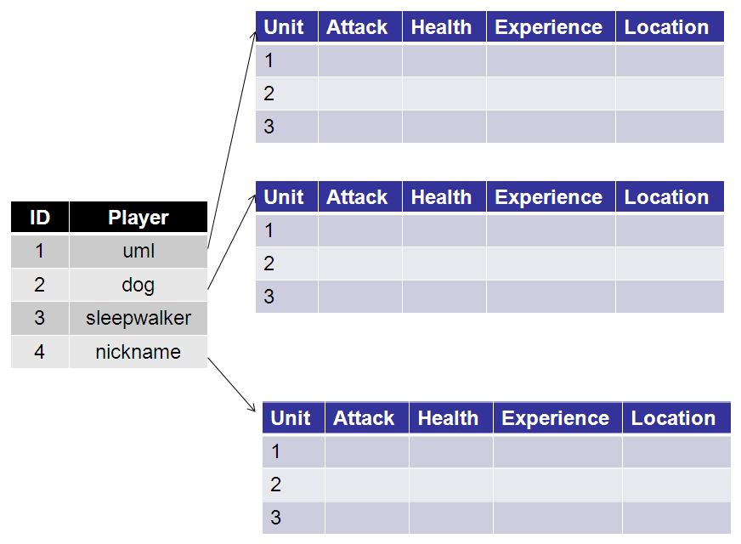
Database “How Database works”

Slide 36
Database “How Database works”
OpenGL
User
Interface
Game
Mechanics
Database
The database module interacts with other modules, but does not affect them. It shall provide operation function by other modules. Such as: read(); write().

Slide 37
Database “Conclusion”
Database functions like a background support to other modules.
Database provides good organization of the game data.
Database is useful for Storage and Retrieval of map and unit Data.

Slide 38
Summary

Slide 39
Conclusion
Conclude this presentation
Told you about our awesome game
Pre-orders available

Slide 40
Questions?

